Slide 1
Ict Ganpat university
PROJECT WORK ON STUDENT LIFE CYCLE MANAGEMENT SYSTEM.

Slide 2
HEY GUYS, WELL THIS IS ANKIT OF ICT GANPAT UNIVERSITY OF SEMESTER 01 BRANCH BIG DATA AND ANALYSIS ENROLLMENT NUMBER: BDA 12 AND TODAY I AM HERE TO SHOW YOU MY PRESENTATION AND PROJECT WORK ON A VERY COMMON BUT IMPORTANT TOPIC OF STUDENT LIFE CYCLE MANAGEMENT SYSTEM.

Slide 3
IN THIS PROJECT :
HERE IN THIS PRESENTATION AT FIRST I AM GOING TO TELL YOU A MORE LITTLE BIT OF STUDENT LIFE CYCLE MANAGEMENT SYSTEM.
AFTER THAT IN THIS PRESENTATION I AM GOING TO TELL YOU ABOUT THE FACTORS OF STUDENT LIFE CYCLE MANAGMEMT SYSTEM.
AND THEN IN THIS PRESENTATION I AM GOING TO SHOW YOU THE KEY FEATURES OF STUDENT LIFE CYCLE MANAGEMENT SYSTEM.

Slide 4
IN THIS PROJECT :
AFTER THAT THIS PRESENTATION WILL TELL YOU ABOUT THE ADVANTAGES OF STUDENT LIFE CYCLE MANAGEMENT SYSTEM.
AND THEN I WILL TELL YOU ABOUT MY WEBSITE WHICH I MADE USING C LANGUAGE .
I WILL ATTACH SCRRENSHOT OF BOTH CODES AS WELL AS OUTPUTS IN THIS PRESENTATION .
AND AT EVERY SLIDE OF THIS PRESENTATION I WILL TELL YOU WHAT THIS WILL DO AND WHAT IF WE HAVE PUT WRONG USERNAME AND OUTPUTS.
AND ATLAST THE PROJECT ENDS.

Slide 5
CONCEPTS USED IN THIS PROJECT:
I MADE THIS PROJECT BY USING THE CONCEPTS OF C LANGUAGE INCLUDING POINTERS, ARRAY, AND LOOP.

Slide 6
COMPILER USED :
I USED CODEBLOCK COMPILER TO RUN THE CODE.

Slide 7
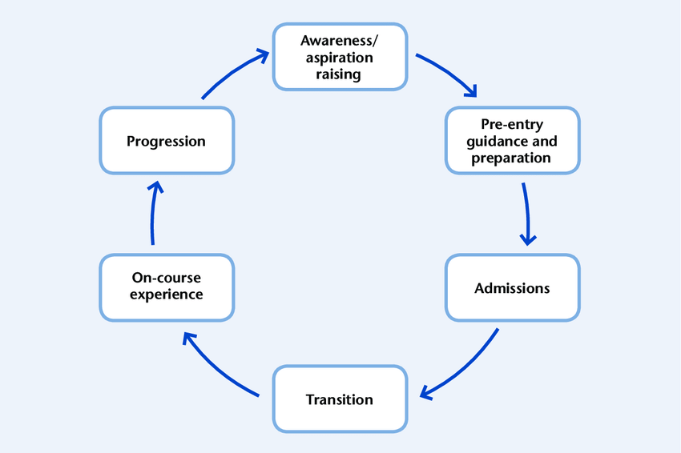
FLOWCHART OF STUDENT LIFE CYCLE MANAGEMENT SYSTEM

Slide 8
WHAT IS STUDENT LIFE CYCLE MANAGEMENT SYSTEM ?
“A STUDENT LIFE CYCLE IS A DATA-DRIVEN AND HOSLISTIC APPROACH THAT FOCUSES ON ENTIRE STUDENT JOURNEY RIGHT FROM THE INQUIRY FOR ADMISSION TO ALUMNI TO ENSURE STUDENT SUCCESS IN REAL-TIME.”
“A STUDENT INFORMATION SYSTEM CAN ENABLE US TO MANAGE AND CREATE QUICKLY & EASY TO-USE STUDENT PROFILE INFORMATION, THE INQUIRY PROCESS, ENROLLMENT FOR ADMISSION LINK TO ENROLL, SCHEDULDE, TRANSCRIPT, AND DEGREE EVALUATION, AND SHARE RECORDS WITH FACULTIES, AND ADMINSTRATIONS.”

Slide 9
FACTORS OF STUDENT LIFE CYCLE MANAGEMENT SYSTEM :
INQUIRY FOR ADMISSION
ADMISSION PROCESS
FEE STRUCTURE
PROGRAM AND COURSE STRUCTURE
TIMETABLE
ATTENDENCE RECORD
EXAMINATION
ALUMINI MANAGEMENT
CLOSING NOTES

Slide 10
KEY FEATURES OF STUDENT LIFE CYCLE MANAGEMENT SYSTEM :
CLEAR BILLING BREKDOWNS AND PAYMENT MANAGEMENTS.
DIGITAL REGISTRATION AND CONSTENT FORM
PROGRESS TRACKING AND LESSON MANAGEMENT
SECURE MESSAGING
SCHOOL MANAGEMENT
ATTENDENCE MANAGEMENT
STUDENT ADMISSIONS AND APPLICATION PROCESS
SELF-SERVICE PORTALS FOR PARENTS, STUDENTS AND FACULTY
SUMMATIVE, FORMATIVE AND DIAGONASTIC ASSESSMENTS
STUDENT ADMISSION AND ONBOARDING

Slide 11
ADVANTAGES OF STUDENT MANAGEMENT SYSTEM :
. INCREASES PRODUCTIVITY :
DEPLOYING THE RIGH STUDENT MANAGEMENT SYSTEM MEANS SPENDING LESS TIME MAINTAINING RECORDS AND MORE TIME FOCUSED ON SCHOOLS.

Slide 12
ADVANTAGES OF STUDENT LIFE CYCLE MANAGEMENT SYSTEM
. STREAMLINED, SIMPLIFIED TASKS
STUDENT MANAGEMENT SYSTEM EMPOWERS TEACHERS TO NOT ONLY KEEP TRACK OF EACH STUDENT’S PROGRESS, BUT ALSO TAKE IMMEDIATE ACTION TO COURSE-CORRECT OR PROVIDE ASSSISTANCE AS NEEDED

Slide 13
ADVANTAGES OF STUDENT LIFE CYCLE MANAGEMENT SYSTEM :
. IMPROVED COMMUNICATION
MODERN STUDENT MANAGEMENT SYSTEM ALLOW STUDENTS AND PARENTS TO EASILY CONNECT WITH THEIR TEACHERS IN AN ENVIRONMENT WHWRE ALL ESSENTIAL DATA IS ACCESSIBLE UPFRONT. THIS ALLOW A STUDENT’S PARENT TO TAKE A ACTIVE ROLE IN THEIR EDUCATION, WHILE ALSO EMPOWERING THE STUDENT TO MORE EASILY ASK QUESTIONS OR SEEK HELP.

Slide 14
ADVANTAGES OF STUDENT LIFE CYCLE MANAGEMENT SYSTEM :
. ACCESS TO INFORMATION
A STUDENT MANAGEMENT SYSTEM MAKES IT POSSIBLE FOR PARENTS TO GAIN TOTAL VISIBLITY INTO THEIR CHILDREN’S SCHOOL ACTIVITIES, ASSINGMENTS, ATTENDENCE AND PERFORMANCES. IT ALSO MEAN A SMOOTHER TRANSISTION BETWEEN CLASSES AND GRADES, AS ALL TEACHES HAVE ACCESS TO A SINGLE SOURCE OF TRUTH ABOUT THEIR STUDENT’S PERFORMANCE.

Slide 15
ADVANTAGES OF STUDENT LIFE CYCLE MANAGEMENT SYSTEM:
.STUDENT TRACKING
SCHOOL ACTIVITIES BEYOND THE WALL OF THE CLASSROOM. IT ALSO INCLUDES EXTRACURRICULAR SUCH AS SPORTS AND CLUBS, IN ADDITION TO DETAILS ABOUT A STUDENT’S HOME LIFE. WITH A STUDENT MANAGEMENT SYSTEM, THIS INFORMATION IS KEPT IN ONE PLACE, MAKING IT FAR SIMPLER FOR TEACHERS TO KEEP TRACK TO THEIR STUDENTSS AND IDENTIFY WHICH ONE IS STRUGGLING.

Slide 16
ADVANTAGES OF SCHOOL LIFE CYCLE MANAGEMENT SYSTEM:
REDUCE WORKLOAD:
THE COST INCURRED FROM MANUALLY MANAGING STUDENTS AND SCHOOL ACTIVITIES IS OFTEN STAGGERING FROM NOT ONLY A BUDGETARY STANDPOINT, BUT ALSO IN TERMS OF TIME. WITH A STUDENT MANAGEMENT SYSTEM, TEACHERS CAN SPEND LESS TIME HOLDING UP TO HOLDING UP THE FOUNDATION OF THE STUDENT EXPERIENCE, AND MORE TIME IN CLASSROOM.

Slide 17
ADVANTAGES OF STUDENT LIFE CYCLE MANAGEMENT SYSTEM :
SUSTAINABLITY
BETWEEN PHYSICAL FILES, RECORDS, AND FORMS, A SINGLE SCHOOL MAY GO THROUGH IMMENSE AMOUNT OF PAPER. IMPLEMENTING CLOUD-BASED STUDENT MANAGEMENT SOFTWARE ALLOWS A SCHOOL TO DIGITIZE THE MAJORITY OF THIS DOCUMENTATION. NOT ONLY DOES THIS CREATE A DIGITAL AUDIT TRAIL, IT ALSO GREATLY REDUCES THE AMOUNT PAPER A SCHOOL REQUIRES, MAKING THE SCHOOL MORE SUSTAINABLE IN THE PROCESS

Slide 18
ADVANTAGES OF SCHOOL LIFE CYCLE MANAGEMENT SYSTEM
ACCESS FROM ANYWHERE
TO THE RIGHT PEOPLE, STUDENT MANAGEMENT SOFTWARE IS ACCESSIBLE FROM ANYWHERE AND AT ANY TIME. ALL A STAKEHOLDER REQUIRES IS A SMARTPHONE, TABLETS, OR PC TO IMMEDIATELY LOOK UP RELEVANT STUDENT INFORMATION. IN THE LONG-TERM, THIS FACILITATES BETTER INFORMATION SHARING BETWEEN BOTHJ EDUCATORS AND SCHOOLS. A RECORD OF EVERYTHING CAN BE KEPT DUEBTONEASY ACCESSIBILITY.

Slide 19
ADVANTAGES OF STUDENT LIFE CYCLE MANAGEMENT SYSTEM :
TRANSPARENCY AND ACCOUNTABLITY
BECAUSE A STUDENT MANAGEMENT SYSTEM GIVES EVERYONE INVOLVED IN A STUDENT’S EDUCATION ACCESS TO A WELL-ORGANIZED COLLECTION OF DATA ABOUT THE STUDENT, IT’S FAR EASIER TO KEEP EVERYONE ACCOUNTABLE AND ON-TASK.

Slide 20
ABOUT THE WEBSITE

Slide 21
LOGIN PAGE:
ABOUT LOGIN PAGE :
HERE, AT FIRST SCHOOLS WILL USERNAME AND PASSWORD TO STUDENTS. WHEN STUDENT ENTER THEIR CORRECT USERNAME AND PASSWORD THEN IT WILL SHOW LOGIN SUCCESSFULLY AND THEN NEXT PAGE WILL OPEN. AND IF WE ENTER INCORRECT USERNAME OR PASSWORD THE PAGE SHOW YOU HAVE ENTER INCORRECT USERNAME OR PASSWORD.

Slide 22
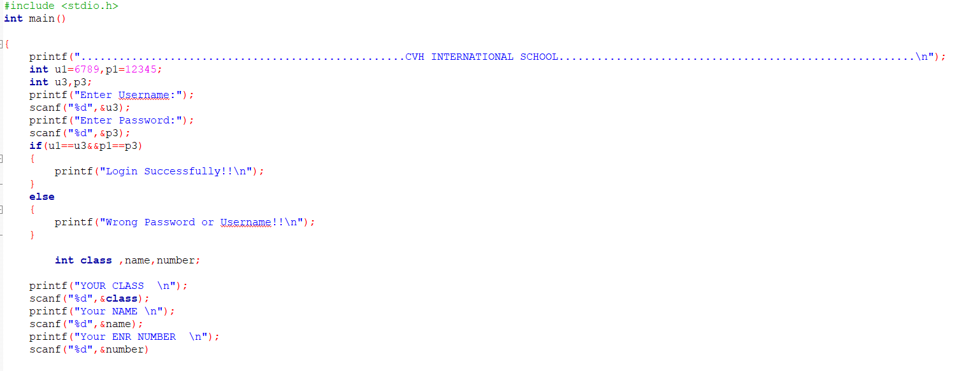
CODE FOR LOGIN PAGE :

Slide 23
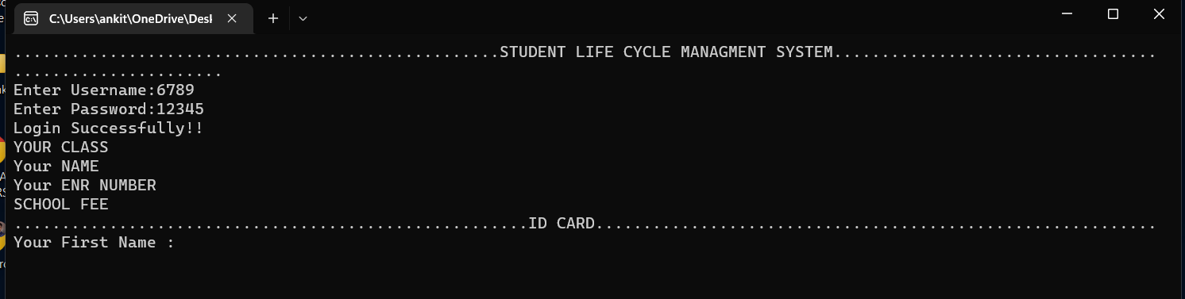
OUTPUT {IF USER NAME IS CORRECT}

Slide 24
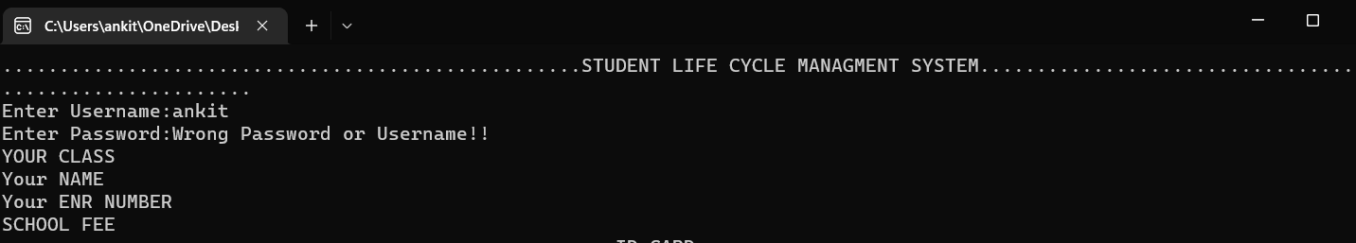
Output{if user name is incorrect}

Slide 25
1ST PAGE OF WEBSITE:
WHEN WE ENTER CORRECT USERNAME AND PASSWORD THEN AFTER THAT THE COMPILER ASK YOUR NAME
WHEN YOUR ENTER YOUR NAME THEN IT WILL ASK YOU ABOUT YOUR LAST NAME .
AND THEN AFTER IT WILL ASK YOU ABOUT YOUR AGE
AND THEN AFTER IT WILL ASK YOUR CONTACT DETAILS AS WELL AS ENROLLMENT NUMBER.

Slide 26
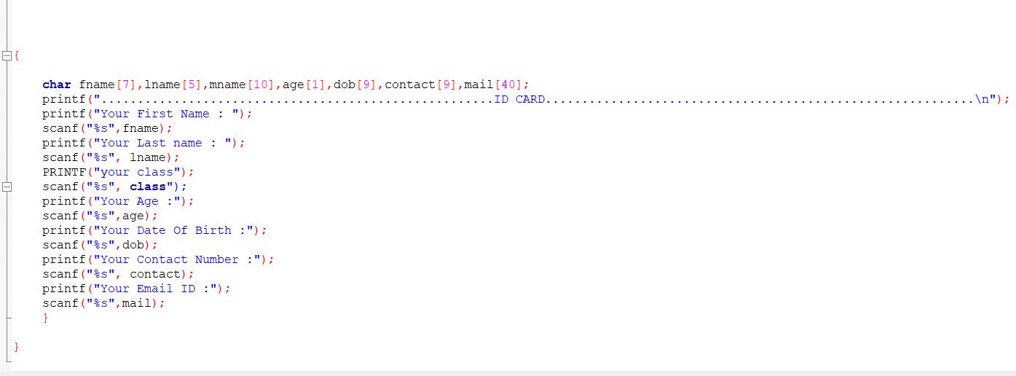
CODE FOR 1ST PAGE

Slide 27
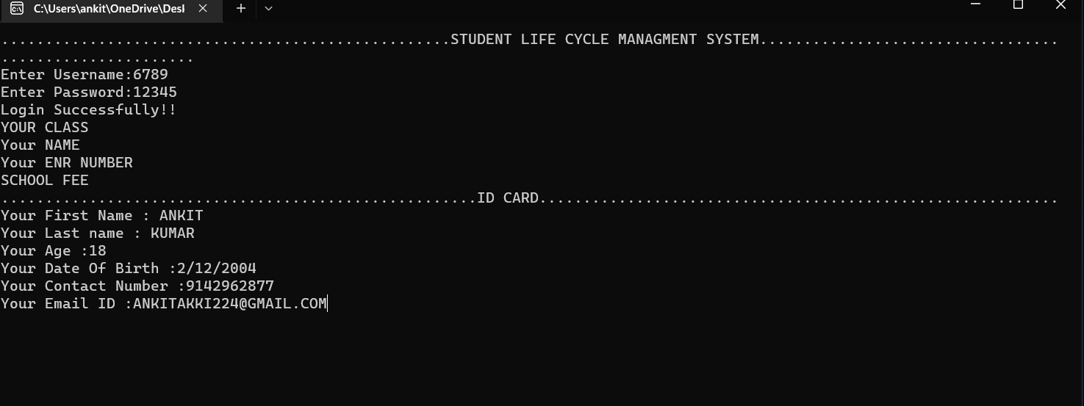
OUTPUT FOR 1ST PAGE:

